Slide 1
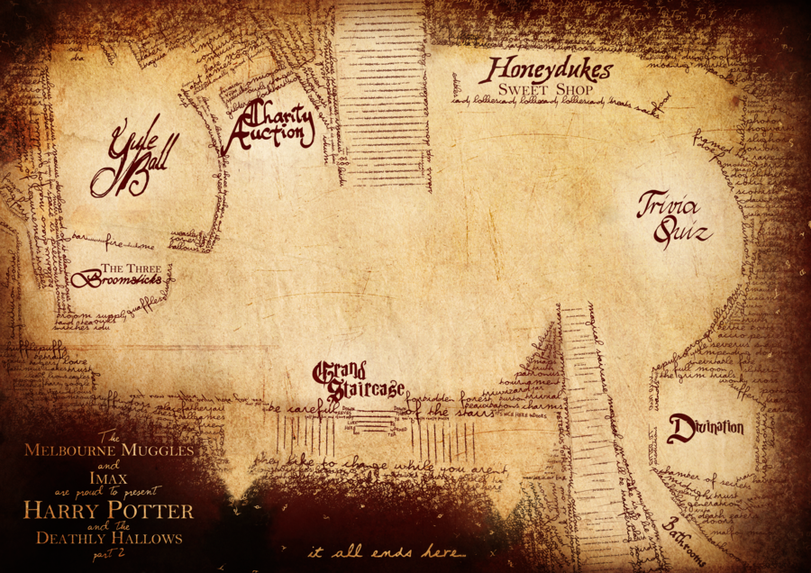
Text Analysis On The Harry Potter Series
By: Josiah Ridgeway

Slide 2
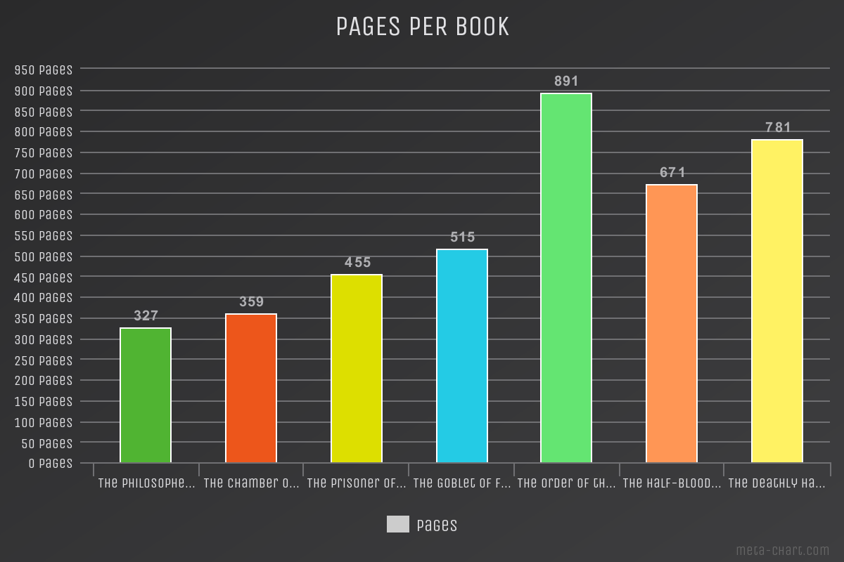
Notes:
As you can see the books begin small at about 350 pages in the Philosopher's Stone and the Chamber of Secrets as the series hits the middle we find ourselves in the 400 to 500 page range. When we to the last three the average page number has increased substantially, with the 5th book The Order of the Phoenix being the largest.

Slide 3
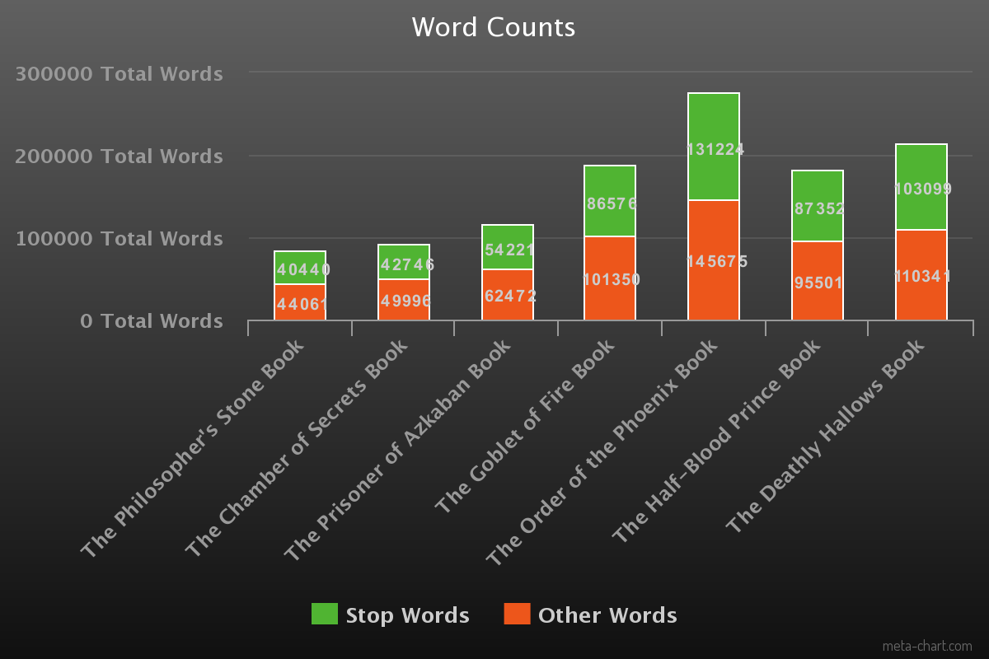
Notes:
The word count of each book follows the same trend as the page counts. With the first book being under 100 thousand words and 5th pushing 300 thousand words. Stop words such as “and” and other words such as ”Harry” seem to be close to evenly split although it does skew towards words others. This is interesting however as the amount of individual stop-words only numbers at around 150.

Slide 4
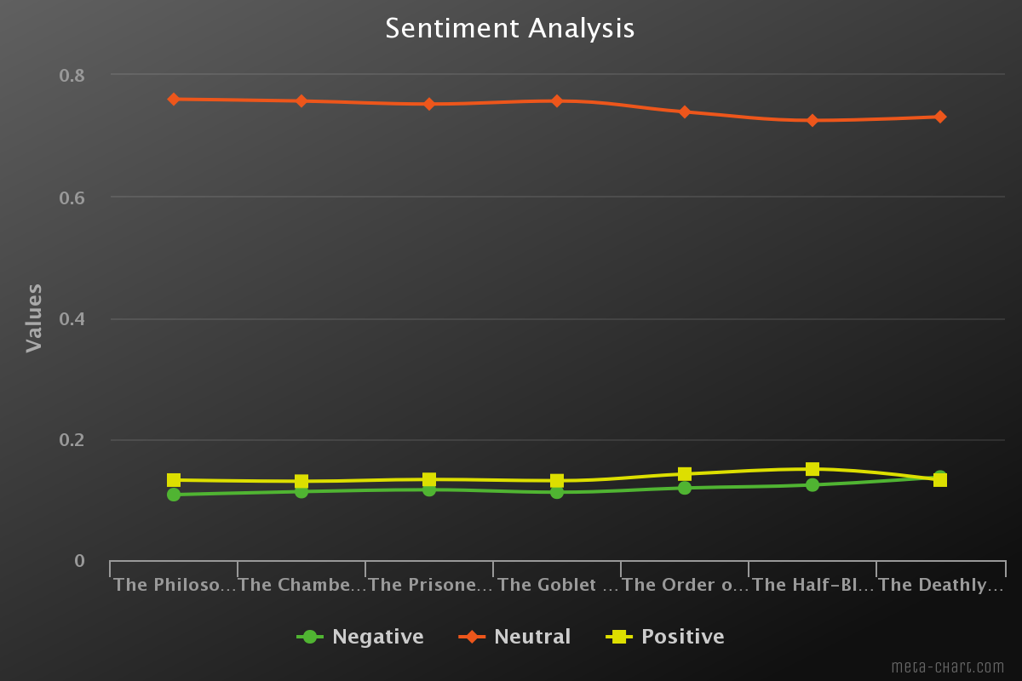
Notes:
When looking at the overall sentiment of each book we can see that the overall most words are neutral. However, there are subtle differences as we look at different points in the series. In the first book, the Philosophers Stone, we see one of the largest differences in sentiment with positive words making up 13.2% of the book and negative words coming in at 10.8%. The next four books keep about a two percent difference between positive and negative words with positive being more prevalent. The sixth book, The Half-Blood Prince, brings us back to a more positive tone with 15% of the non-stop words having a positive connotation and 12.4 words having a negative one. This making it the most positive book in the series. It would also seem that is the most opinionated book in the series as it has the lowest amount of neutrally ranked words at 72.5%. This downward trend begins in the Order of the Phoenix, but dissipates slightly as the series closes in the Deathly Hollows. The final book is contains 73.1% neutral words and also comes out as our most negatively tilted book marking it the darkest one in the series at 13.7% of the words with a negative sentiment and 13.2% with a more positive sentiment. This marks the only time where positive did not outweigh the negative in the entire series.

Slide 5
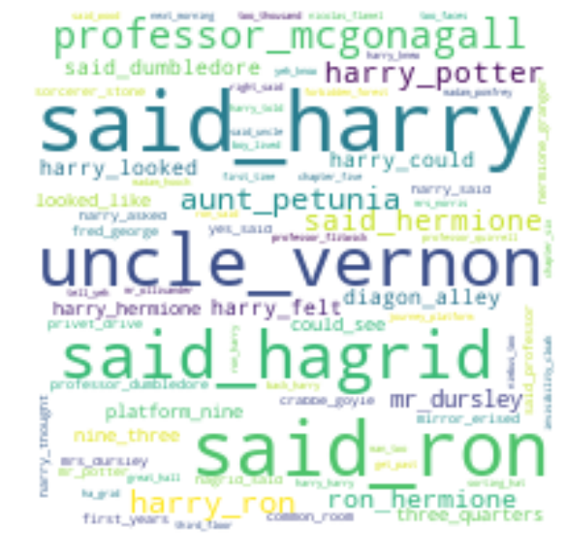
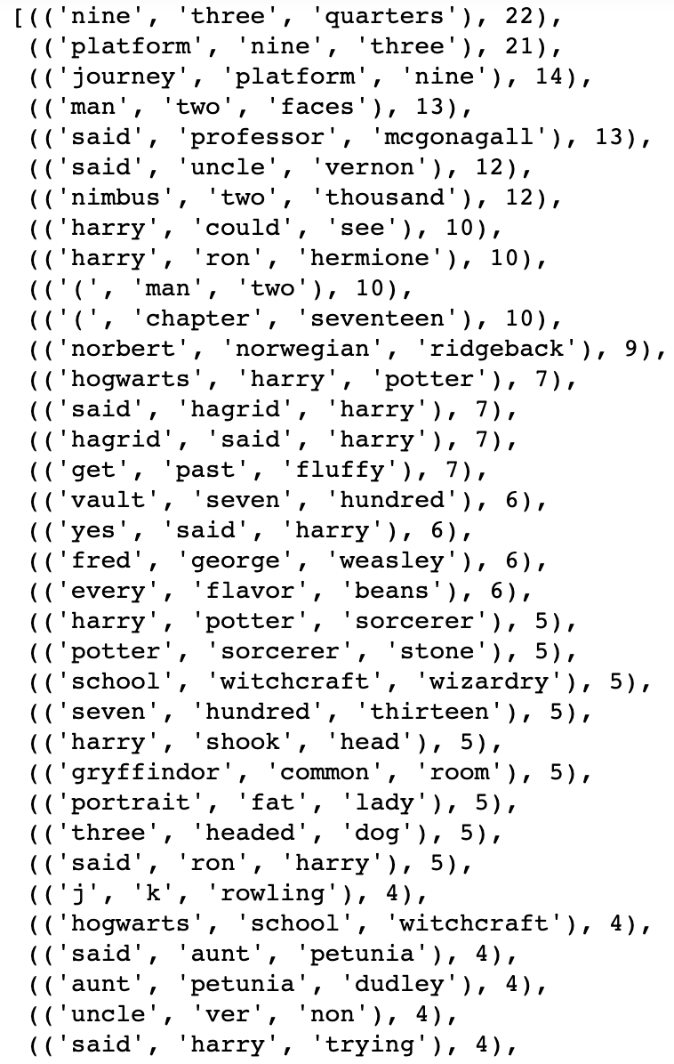
Notes:
When looking at the Ngrams functions from the NLTK library we can pick out important terms and gain some insight into the book. Using a wordcloud and bigrams which pick out two words in proximity we can see the most common words used in conjunction with each other. Here we can see that Harry, Ron, and Hagrid seem to have the most speaking time in the book. We can also see other important people in the book such as Uncle Vernon and Aunt Petunia along with important places like Platform Nine. In the trigrams function we can also see important aspects of the books. The nimbus two thousand for instance was a high performance broomstick Harry was able to obtain. We can also see the Gryffindor Common room where our heros spend much of their time.

Slide 6
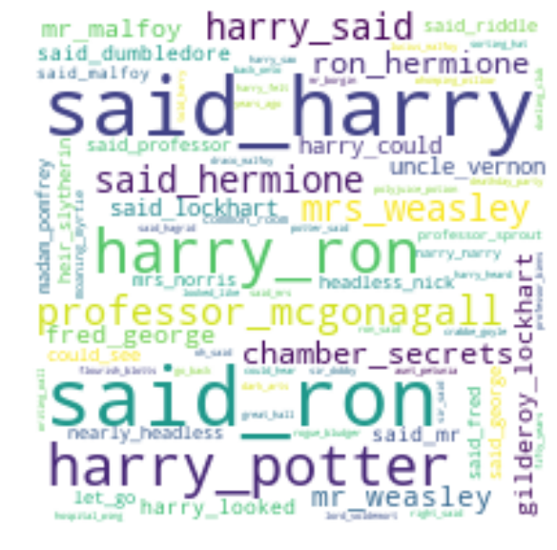
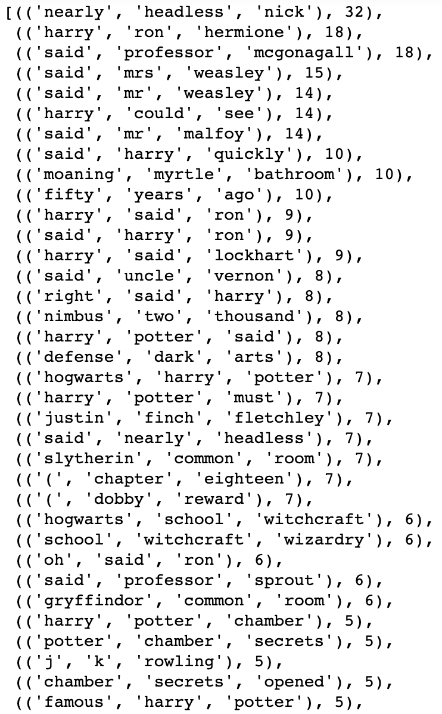
Notes:
Again we can see our most important characters along with common themes. In the Word Cloud we can see the Chamber of Secrets which also happens to be the name of the book as a common word along with other bigrams such Headless Nick. This character tops the Trigrams list at 32 mentions within the book followed by our heroes Harry, Ron, and Hermione. We can also notice themes such as the Defenses Against the Dark Arts at 7 mentions or the Hogwarts School of Witchcraft.

Slide 7
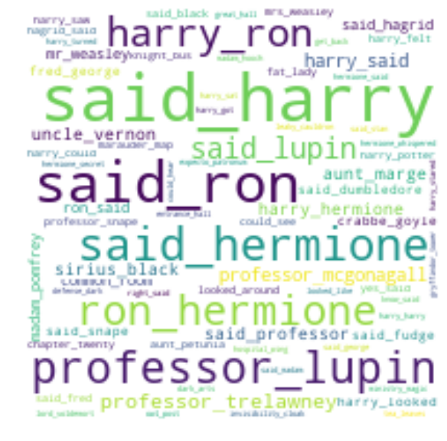
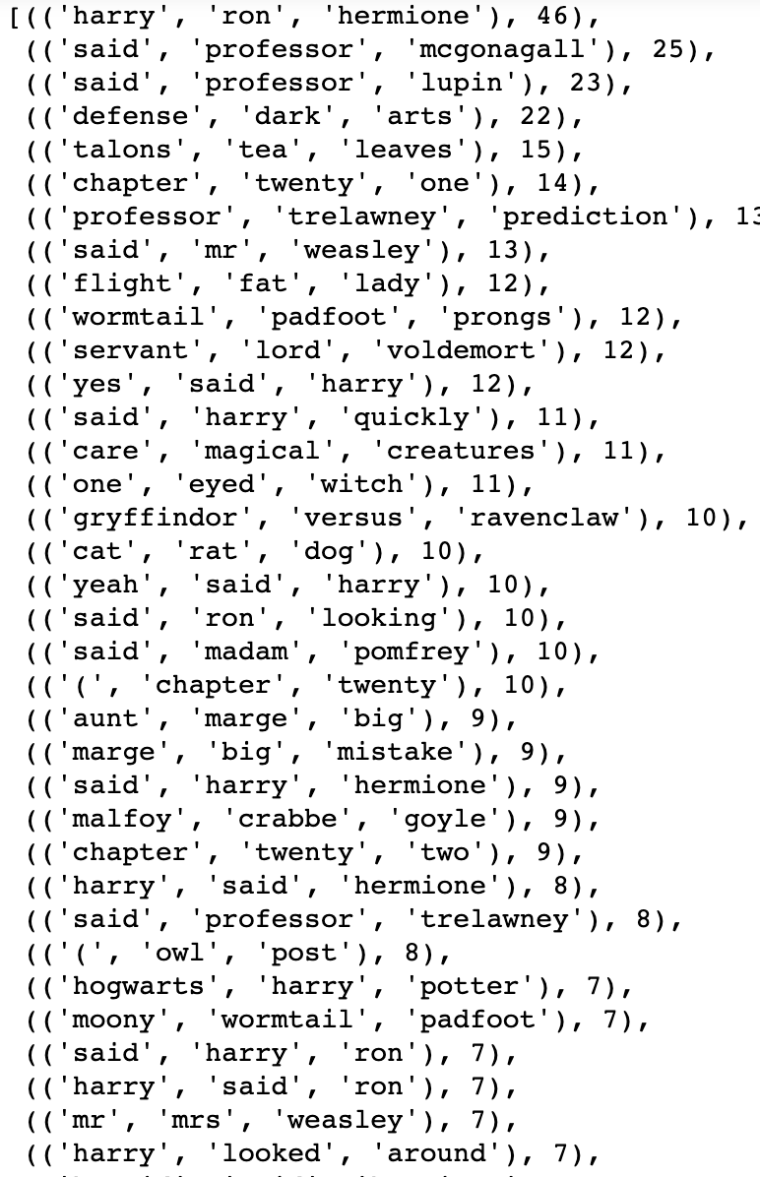
Notes:
In book three we can notice Sirius Black in our Bigrams who happens to be the Prisoner in Azcaban for which the book is named. We can also se Griffandor vs Ravenclaw which if memory serves me references a high stakes sports game between two of Hogwarts classes.

Slide 8
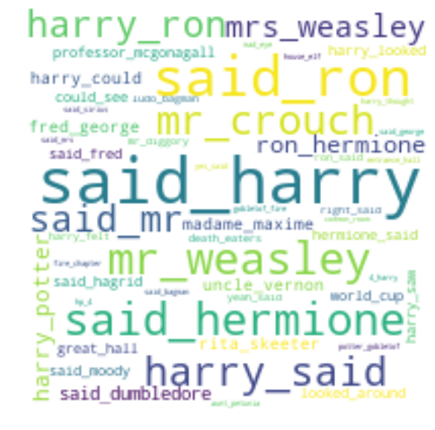
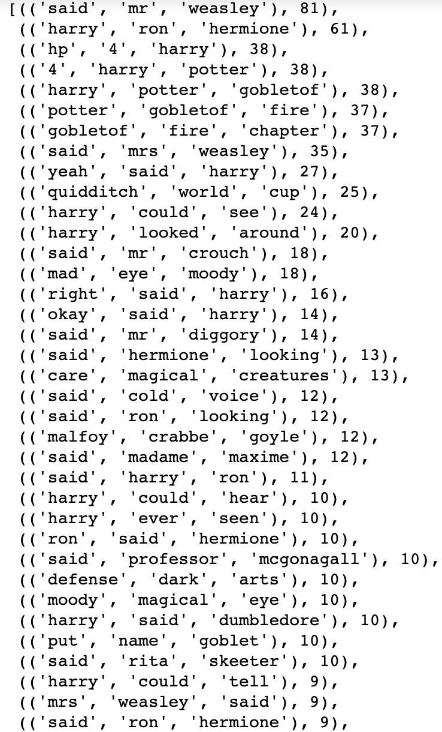
Notes:
Book 4 Goblet of Fire our NGRAMS mainly point to people which may be in line with the books them that centers around the Goblet of Fire which can be found in the TriGrams. We can also notice the Quiditich World Cu which is also a tournament.

Slide 9
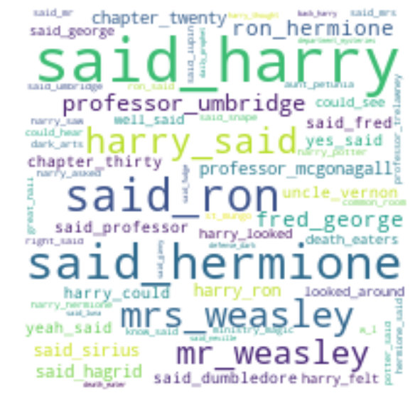
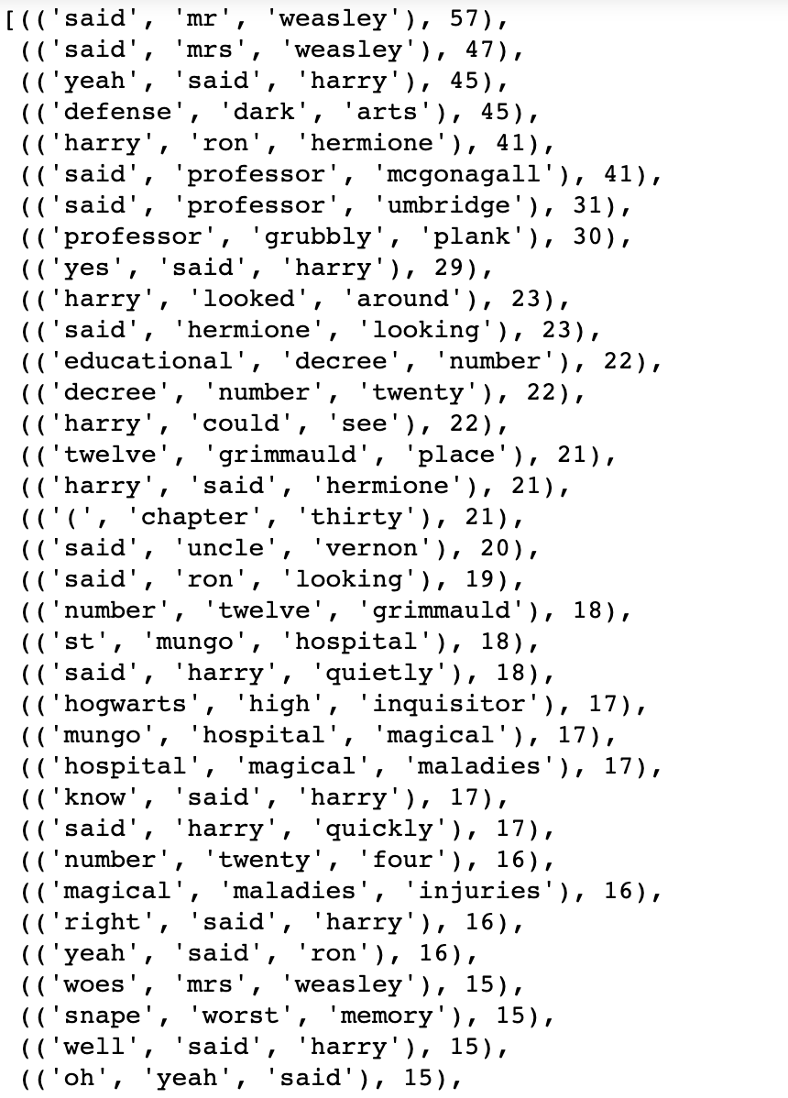
Notes:
Book 5 Hospital of Magical Maldgies

Slide 10
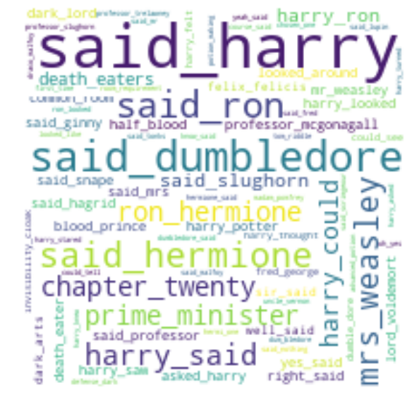
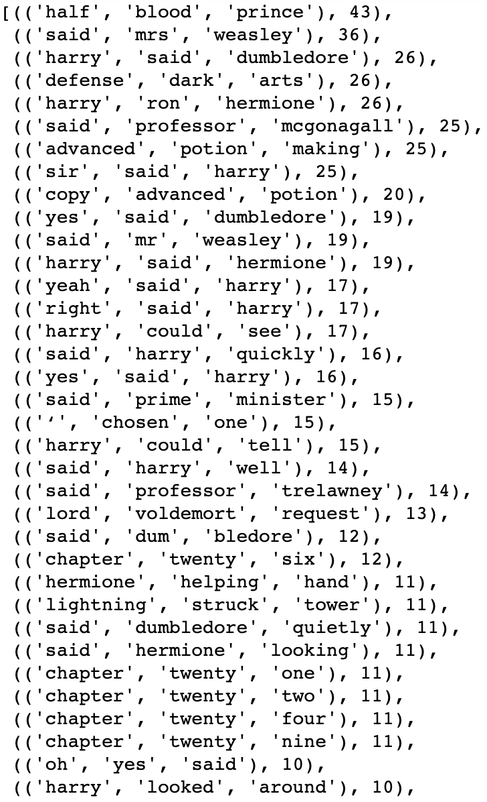
Notes:
Book 6 Half Blood Prince, the Dark arts, Voldermort,

Slide 11
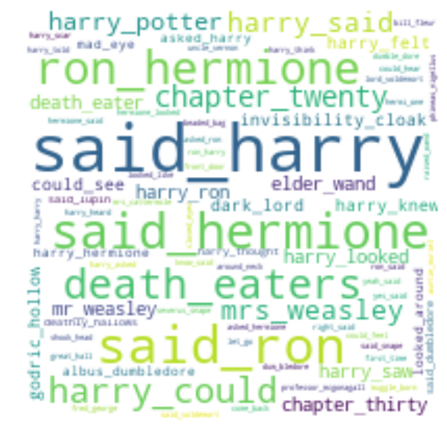
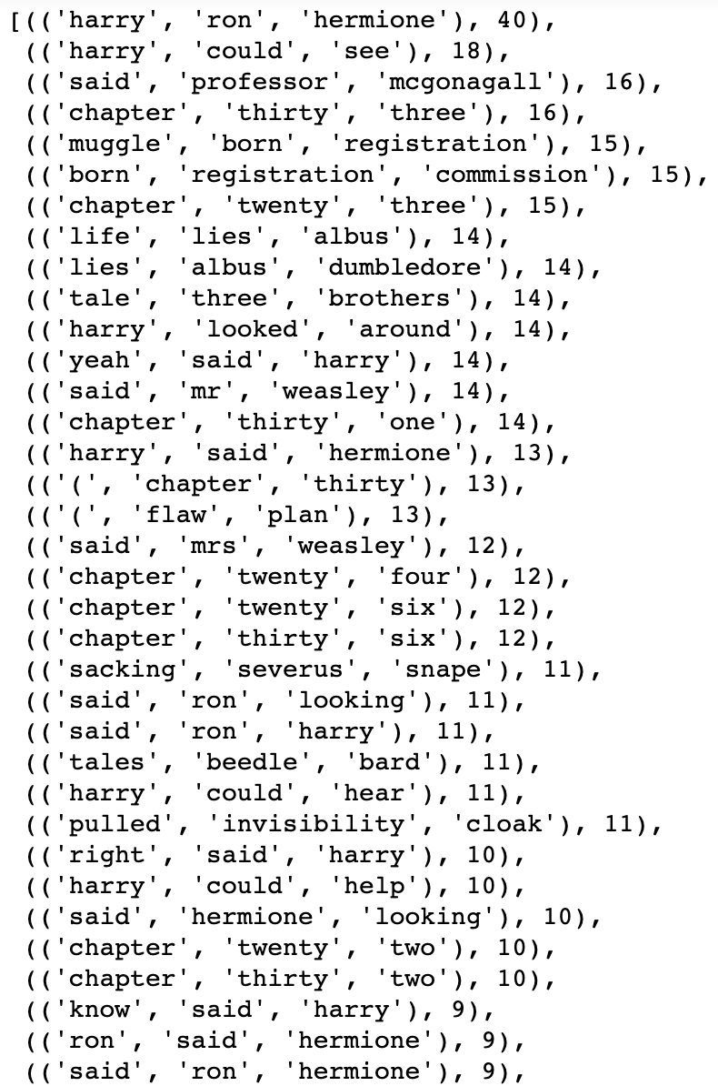
Notes:
Book 6 Dark Lord, Deathly Hallows, Death Eaters in Bigrams, The sacking of Sevrerus Snape. The Life and lies of Dumbledore, and the Muggle Born Registration in which a commission inquired as to how human born people must haven stolen their power from real wizards. Which keeps in line with our darker them. We also see Ron and Hermonie prominently featured in the Word Cloud which also signifies their significance as a couple in this book as opposed to previous books.

Slide 12
Thank You For Your Time
Notes:
Book 6 Half Blood Prince

